Slide 1



Geospatial re-evaluation of Bison remains from the greater Grand Canyon area and Colorado Plateau: native or non-native?
Jeff M. Martin and Jim I. Mead
East Tennessee State University Geosciences Master’s Candidate
In Paleontology
Project funded in part by:
NAPC, Feb., 2014

Slide 2
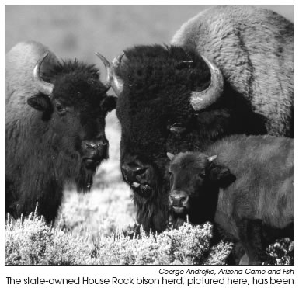
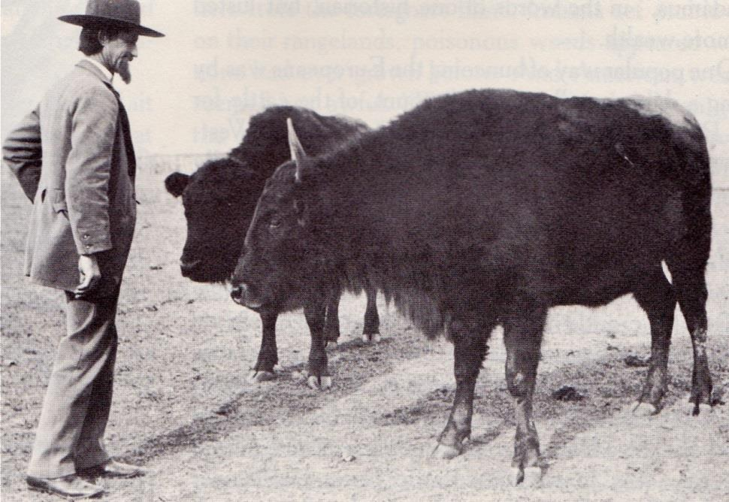
House Rock Valley Wildlife Area Bison History
This is what Kaibab ‘cattalo’ looked like 110 years ago
1905 – C.J. “Buffalo” Jones introduce bison to North Rim of the Grand Canyon
Crossbred these bison with cattle and created ‘cattalo’
Thought to be hardy for the dry conditions and be more productive on less grass
These animals, however, prove to be difficult to breed unless there is either greater than 5/8 cattle or 5/8 bison genes
350 individuals thrive today in the HRVWA herd
Minard, 2010
This is what Kaibab ‘cattalo’ look like today

Slide 3
Framing the Question
Are Bison recently native to the Grand Canyon?
Native
What is recent/historic?
Bison
“All species that have occurred, now occur, or may occur as a result of natural processes on lands designated as units of the national park system… [and] are evolving in concert with each other” NPS
Geologic?
Cultural?
Species?
Genus?
“With respect to a particular ecosystem, a species that, other than as a result of an introduction, historically occurred or currently occurs in that ecosystem” Fed. Gov’t.
Pleistocene?
Holocene?
Anthropocene?
Since 1776?
1565 CE?
1200 CE?
How good is the written record?
Only Bison bison ~5000 years
7 N.A. species
3 since 20 kya
Notes:
with respect to a particular ecosystem, a species that, other than as a result of an introduction, historically occurred or currently occurs in that ecosystem” (Executive Order 13112, Section 1) and “all species that have occurred, now occur, or may occur as a result of natural processes on lands designated as units of the national park system… [and] are evolving in concert with each other” (U.S. Dept. of the Interior and National Park Service, 2006).
Moreover, the state of Arizona defines “wild” as “in reference to mammals and birds, those species which are normally found in a state of nature” and “wildlife” as “all wild mammals, wild birds and the nests or eggs thereof... including their eggs or spawn” (Arizona Revised Statutes, Title 17 – Game and Fish, Chapter 1, Article 1, Section A, 22-23). And such Arizona wildlife includes “game mammals [being] deer, elk, bear, pronghorn (antelope), bighorn sheep, bison (buffalo), peccary (javelina), mountain lion, tree squirrel and cottontail rabbit” (Arizona Revised Statutes, Title 17 – Game and Fish, Chapter 1, Article 1, Section B, 2). However, some use Arizona Revised Statutes 3-1401 (Title 3 – Agriculture) to argue that, in the state of Arizona, bison are not wildlife, but “stray animals” defined as “livestock, bison or ratites whose owner is unknown or cannot be located, or any such animal whose owner is known but permits the animal to roam at large on the streets, alleys, roads, range or premises of another without permission, except that this section does not apply to livestock where the principles of a federal permit, federal allotment or federal lease are in dispute.”

Slide 4
Issues
Fencing
  Little to none – HRVWA to PP
California Condor (Gymnogyps)
  Not native. Occurred over 10,000 years ago, nevertheless, conserved and thrives in GRCA
Donkey (Equus asinus)
  Not native. Equus has not occurred since the last Ice Age
Circular Reasoning
  It has always been thought that Bison are not native, so the remains were never identified to be Bison, but Bos taurus, even when site is older than 1565 CE.
Genetics
Cross breeding resulted in impure Bison genes for conservation
Fencing
California Condor
Donkey
Circular Reasoning
Genetics
adapted from Cantino and de Queiroz, 2010; Douglas et al., 2011

Slide 5
Previous Studies
This Study
Recent studies (2012-2013)
Did not review paleontological record
Did not visit paleo or archeo collections
Did not use paleo online databases
  Neotoma DB and MIOMAP (Neogene Mapper)
Did not use GIS for geospatial analysis
Did not use holistic chronologies
Use of these other sources result in 52 sites on CP with bison remains compared to 9
  I found 5 sites with bison misidentified as cattle and 1 as horse
  12+ sites near the CP
Use of GIS results in spatiotemporal analysis
Use of holistic chronology illustrates climatic and cultural patterns

Slide 6
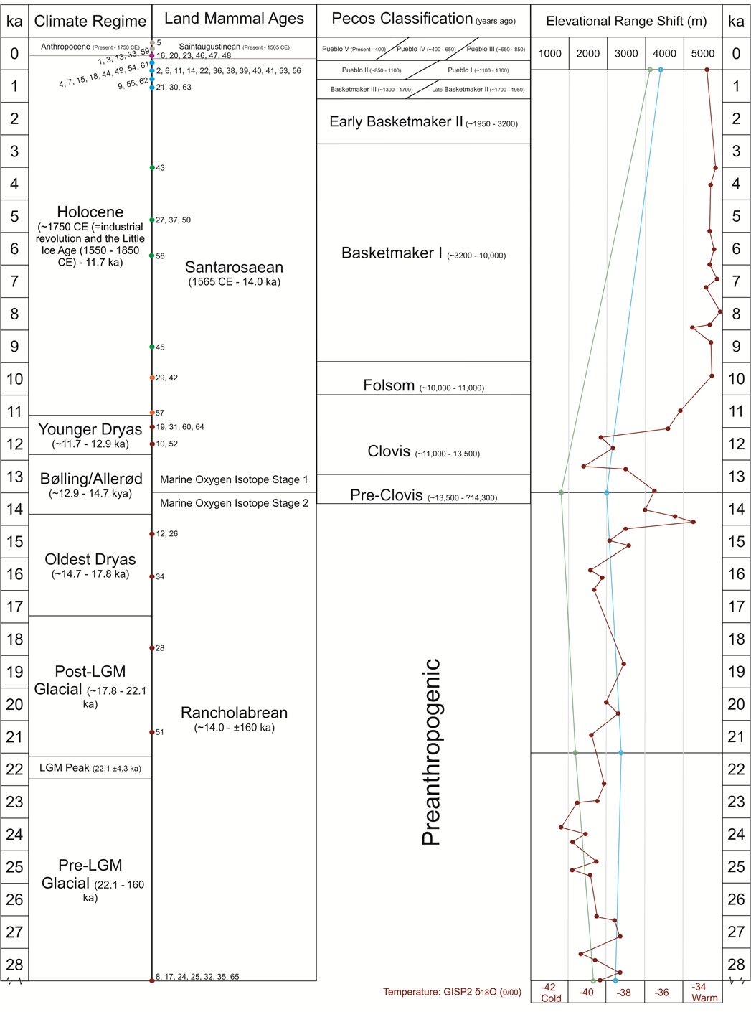
850
1300
3200
10,000
87,000

Slide 7
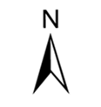
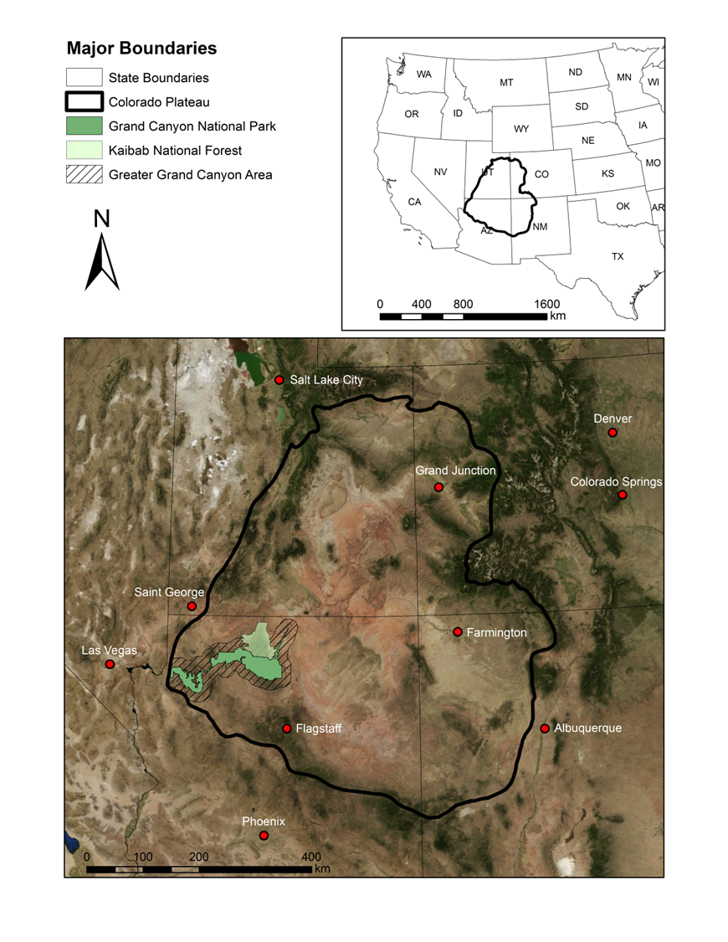

Slide 8
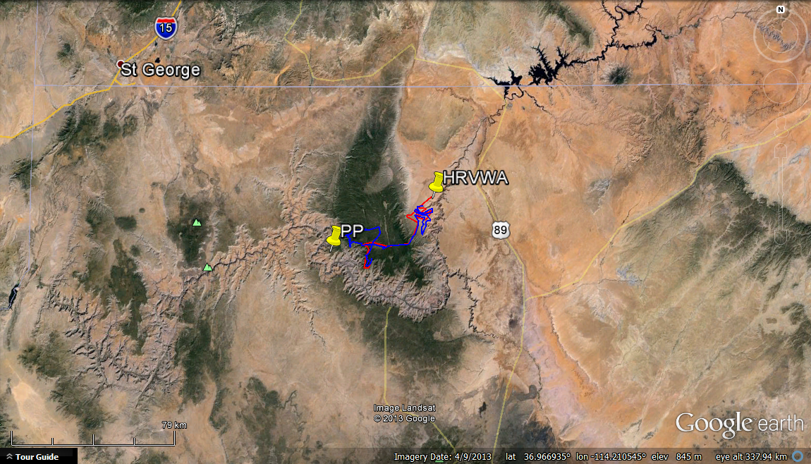
Georeference – Map View
Utah
Arizona
Google Earth, Feb. 2014

Slide 9
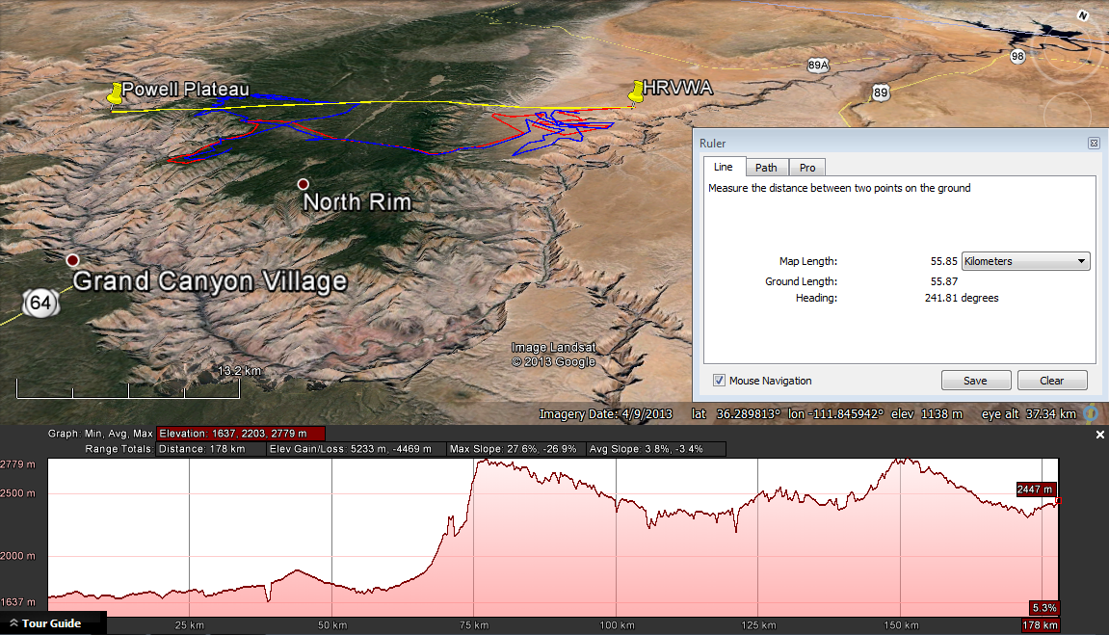
Bison Migration – Landscape View
Yellow Line: HRVWA to Powell Plateau
Gives 56 km radius
Blue Line: Actual Radio-Collar Track of Bison Migration over 5 months
2780 m
178 km
1640 m
Red Line: Addition tracked bison for confirmation.
Google Earth, Feb. 2014
Digitized tracks from Larson et al., 2009

Slide 10
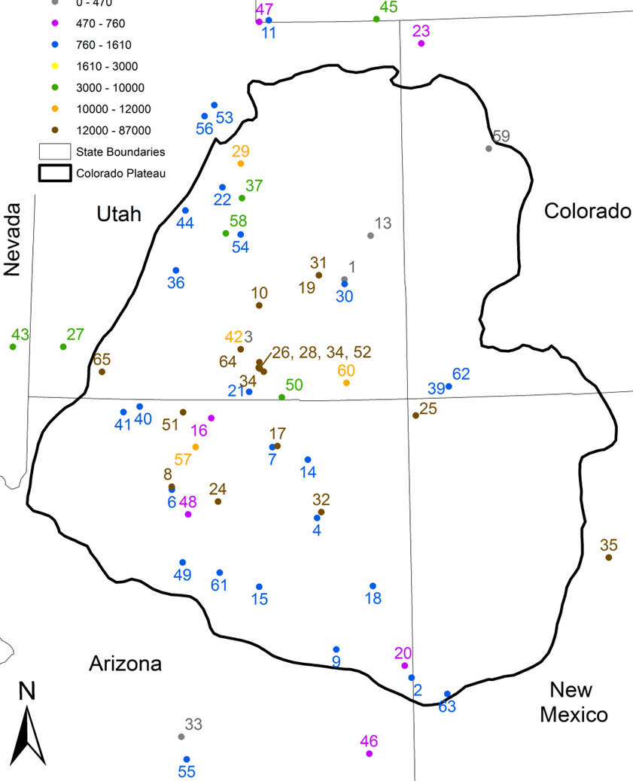
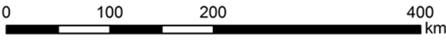

Slide 11
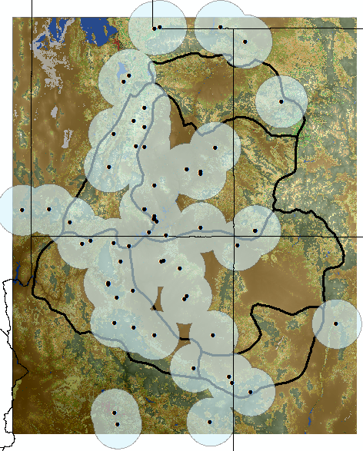
Calculations can then be made!
We know that the herd living on the North Rim in the last decade have traveled nearly 56 km (over a mountain)!
Using this measurement as a minimum, we can infer that bison in the past with no fence-lines traveled at least this distance.
Create a buffer for each bison site and voila!

Slide 12
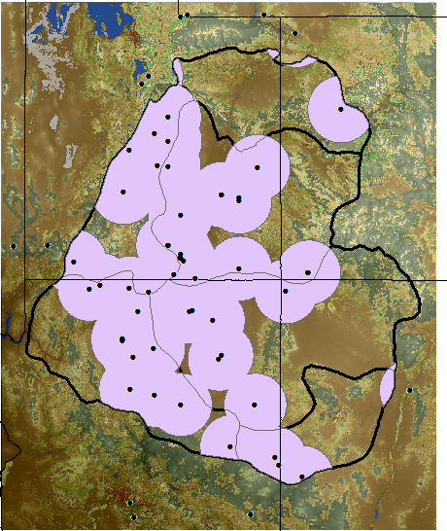
Calculations can then be made!
We know that the herd living on the North Rim in the last decade have traveled nearly 56 km (over a mountain)!
Using this measurement as a minimum, we can infer that bison in the past with no fence-lines traveled at least this distance.
Create a buffer for each bison site and voila!
Now we only want the range in the CP
87000 - Today

Slide 13
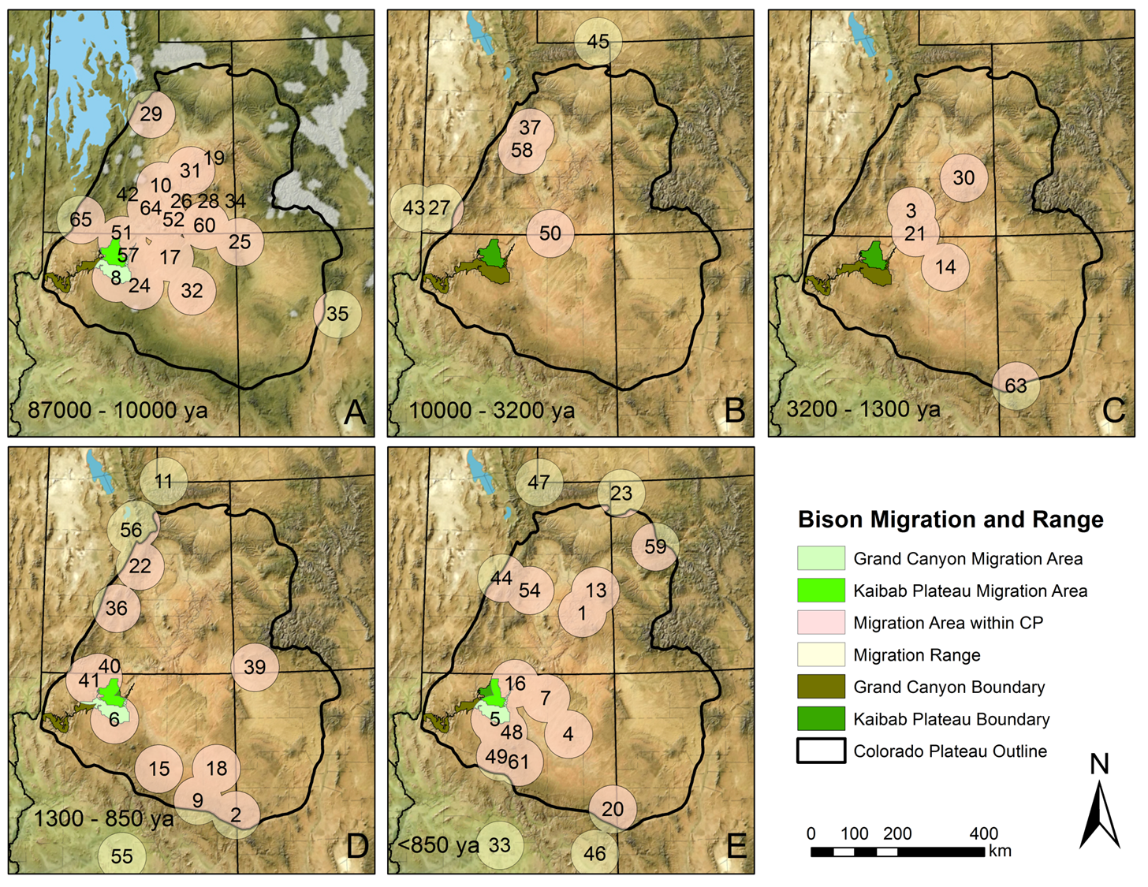
Landform background: Blakey and Ranney, 2008

Slide 14
Landform background: Blakey and Ranney, 2008

Slide 15
Landform background: Blakey and Ranney, 2008

Slide 16
Landform background: Blakey and Ranney, 2008

Slide 17
Landform background: Blakey and Ranney, 2008

Slide 18
Percent of Migration Area per Boundary
Period | Colorado Plateau (334,385 km²) | Greater Grand Canyon Area (16,650 km²) | Grand Canyon National Park (4,860 km²) | Kaibab National Forest (2,408 km²)
87 ka-Today | 56.8% | 58.8% | 61.1% | 100%
87 – 10 ka | 31.0% | 51.0% | 55.1% | 98.2%
10 – 3.2 ka | 7.6% | 0% | 0% | 0%
3.2 – 1.3 ka | 11.9% | 2.9% | 0.03% | 0%
1.3 – .85 ka | 24.5% | 46.6% | 58.9% | 95.6%
< .85 ka | 28.6% | 49.6% | 54.3% | 72.5%

Slide 19
Conclusions
Historically, bison are native to the Colorado Plateau, greater Grand Canyon area, GRCA, and the KNF.
It is necessary to view the paleontological record as well as the archeological record for a complete understanding.
This is an on-going portion of my thesis in which I address conservational implications. I plan on publishing soon! Be on the look out.

Slide 20
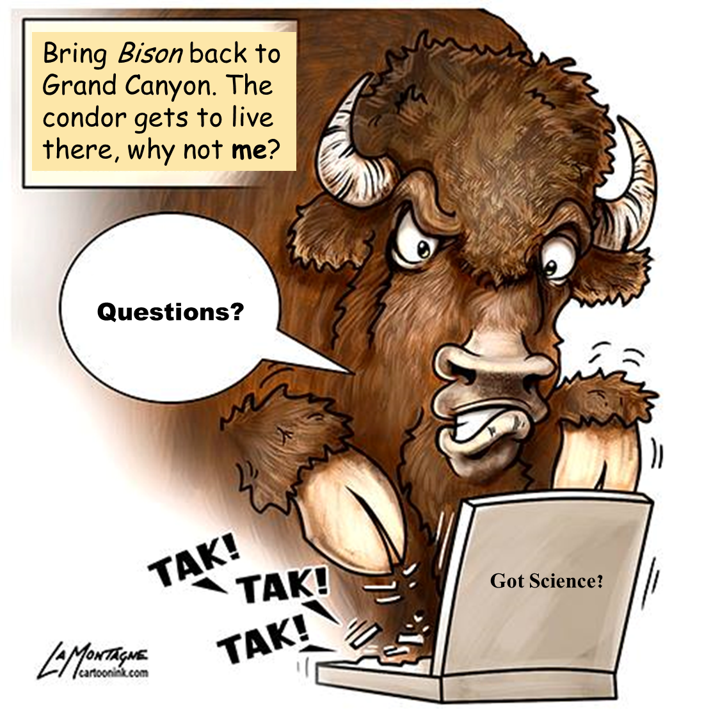
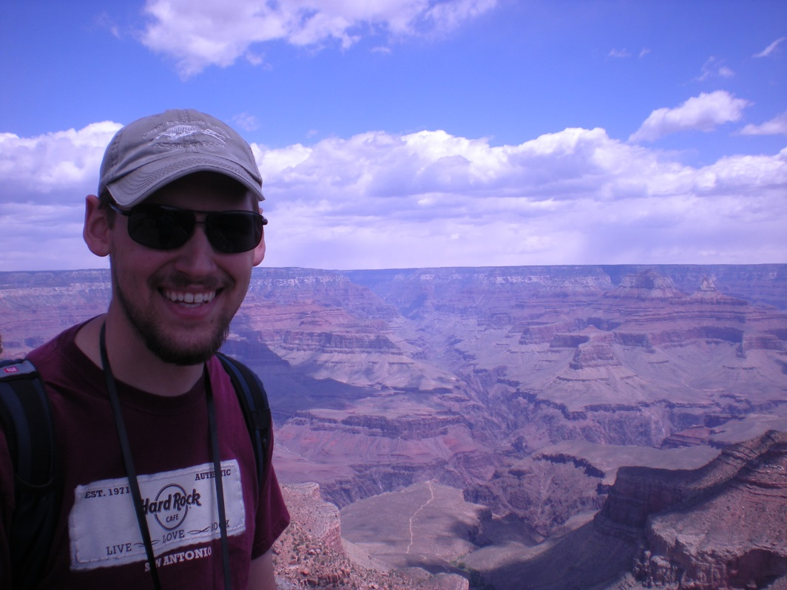

Slide 21
References and Acknowledgements
Blakey, R. C. and Ranney, W. 2008. Ancient Landscapes of the Colorado Plateau: (Grand Canyon). Grand Canyon Association. 176 pp.
Cantino, P. D. and K. de Queiroz. 2010. PhyloCode: International Code of Phylogenetic Nomenclature. Ohio University 4(c): 102 p.
Google. 2014. Google Earth (Version 7.1.2.2041). Available at http://www.google.com/earth/. Accessed 10/7/2013.
Douglas, K. C., N. D. Halbert, C. Kolenda, C. Childers, D. L. Hunter, and J. N. Derr. 2011. Complete mitochondrial DNA sequence analysis of Bison bison and bison-cattle hybrids: function and phylogeny. Mitochondrian 11:166-175.
Larson, A., A. Henn, C. Cultra, C. Ray, K. Wadsak, M. Henn, R. Bergamini, T. Sisk, and C. Hutchinson. Bison in the Grand Canyon Region: implications and recommendations. Unpublished report for Grand Canyon National Park, Arizona Game & Fish Department, U.S. Forest Service, Grand Canyon Trust, and other stakeholders. 34 pp.
Minard, A. 2010. Bison in the Grand Canyon? Four Corners FreePress. February, 2010. Accessed Jan. 2013.
A BIG thanks to:
Access to collections
Museum of Northern Arizona
Grand Canyon National Park
Zion National Park
For funding
The National Buffalo Foundation
Experiment.com
ETSU Don Sundquist Center of Excellence in Paleontology
ETSU Graduate Student Research Grant

Slide 22
Experiment.com Supporters
Pat Monaco
Aimee Finn
Jason P. Schein
Skander Mzali
Hello World
Denny Luan
Amy Billings
Jeffrey Supplee
Carolyn Gilmore
Nancy Greenwood
April Carr
Rachel Pike
Jennifer Barber
Linda Cox
Kimber Short
Andrew Joyner
Sandra Swift
Gail Griffin
Ginger Keller-Ferguson
Kayla Badamo
Thank You for Supporting Science!

